Slide 1
Azure Web Apps
[ Instructor Name ]
[ Instructor E-mail ]

Slide 2





Azure App Service Family
Web Apps
Web apps that scale with your business
Mobile Apps
Build mobile apps for any device
Logic Apps
Automate business processes across SaaS and on-premises
API Apps
Build and consume APIs in the cloud
Notes:
Azure App Service is a PaaS offering that comprises four separate (but related) services:
Web Apps is a fully managed compute platform optimized to host Web sites and Web applications
Mobile Apps provides infrastructure for hosting back-ends for mobile apps -- for example, it provides infrastructure for sending push notifications not only to Windows clients, but to iOS and Android clients as well
API Apps makes it easy to host APIs in the cloud, features integrated support for Swagger (http://swagger.io/), and offers a built-in authentication service for restricting access to APIs
Logic Apps allows you to automate business processes and workflow -- for example, automatically finding negative tweets about your company and sending notifications to a Slack channel
Together, these services comprise a ready-made solution to many of the challenges involved in publishing Web sites, Web apps, Web services, mobile apps, and more.

Slide 3
Azure Web Apps
Support a variety of languages and platforms
.NET, Java, Node.js, PHP, Python, and more
Support scaling (manual or auto) and load balancing
Support slots for staged deployments and A/B testing
Support continuous integration
Familiar and Fast
Leverage existing skills, plus languages, frameworks, and tools you're familiar with
Enterprise Grade
ISO-, SOC2-, and PCO-compliant with enterprise-level SLAs
Global Scale
Scale up and down as needed, manually or automatically
Notes:
The focus of this presentation is Azure Web Apps (https://azure.microsoft.com/en-us/documentation/articles/app-service-web-overview/). This service supports multiple languages and frameworks, including ASP.NET, Node.js, Java, PHP, and Python, so you can "use what you know" to begin leveraging it quickly. It supports scaling (manually or automatically) so capacity can grow as demand grows. It supports deployment slots for staged deployments -- for example, publish to staging, test your changes there, and then swap it into production only after you're confident it is ready. And it supports continuous integration, enabling you to be agile and aggressive in fixing bugs, adding features, and doing everything else needed to keep your site fresh and up to date.

Slide 4
Scaling - Cloud Computing Patterns
Inactivity
Period
Compute
Compute
t
t
On and Off
Unpredictable Bursts
On & off workloads (e.g. batch job)
Over provisioned capacity is wasted
Time to market can be cumbersome
Unexpected/unplanned peak in demand
Sudden spike impacts performance
Can’t over provision for extreme cases
Compute
Compute
t
t
Growing Fast
Predictable Bursts
Successful services needs to grow/scale
Keeping up w/ growth is big IT challenge
Cannot provision hardware fast enough
Services with micro seasonality trends
Peaks due to periodic increased demand
IT complexity and wasted capacity
Notes:
Deploy a Web app on a single server and you'll hit a wall when the demand on that server reaches a certain level. Deploy it in Azure, however, and you can handle bursts through auto-scaling or steady growth through manual scaling.

Slide 5
Scaling Up vs. Scaling Out
Scale Up
Scale Out
Vary the VM size
Vary the VM count
1 Core w/ 1.75 GB RAM 2 Cores w/ 3.5 GB RAM 4 Cores w/ 7 GB RAM
Max 3* instances Max 10 instances Max 20/50** instances
Notes:
With a traditional server farm, there are two ways to scale to meet demand:
Scale up by beefing up the servers (more RAM, more cores, etc.)
Scale out by adding servers
The same holds true for virtual server farms. In App Services, scale up is a choice between B/S/P 1-3, where 1 = 1 Core, 1/75 GB RAM, 2 = 2 Core, 3.5 GB RAM, 3 = 4 Core, 7 GB RAM. You can also scale up/down between tiers (B/S/P), which impacts local HDD storage (10/50/250 GB) as well as the cap on number of instances (3/10/50).
* For 3 instances on Basic, only manual scaling is supported
** For Premium Tier, there is a max of 20 if not using ASEs, and 50 if using ASE’s

Slide 6
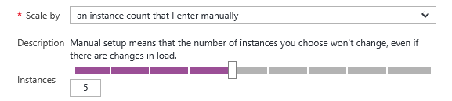
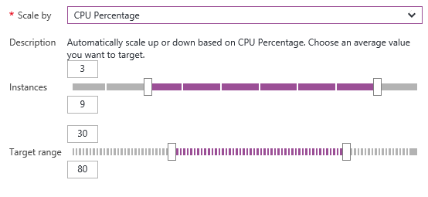
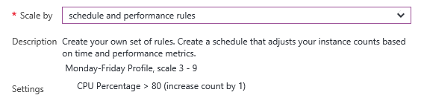
Manual Scaling vs. Auto-Scaling
Manual – Scale via portal or scripts
Auto – CPU Percentage
Auto – Schedule & Performance Rules
Notes:
Manual scaling can be as simple as moving a slider to increase the number of VM instances. Auto-scaling can be enacted by scaling the number of VM instances as CPU utilization increases, or through rules that you specify. An example of the latter is scaling up during certain hours of the day in which you anticipate peak demand.

Slide 7

Web App
Notes:
Demonstrate scaling out in this and the next two slides by showing the VM count increasing as traffic increases.

Slide 8
Web App

Slide 9
Web App

Slide 10
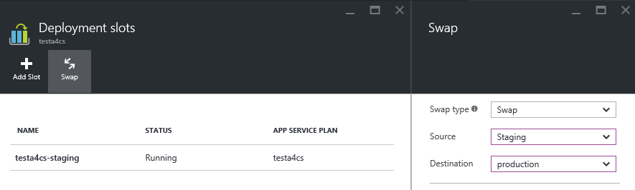
Deployment Slots
Use a Deploy-Confirm-Promote workflow
Promote via “swap” through Azure portal
http://sitename-slotname.azurewebsites.net
Notes:
When you deploy an Azure Web App, you can deploy to a separate deployment slot instead of the default production slot when running in the Standard or Premium App Service plan mode. Deployment slots are actually live web apps with their own hostnames. Web app content and configurations elements can be swapped between two deployment slots, including the production slot. Deploying your application to a deployment slot has the following benefits:
You can validate changes in a staging deployment slot before swapping it with the production slot.
Deploying a web app to a slot first and swapping it into production ensures that all instances of the slot are warmed up before being swapped into production. This eliminates downtime when you deploy your web app. The traffic redirection is seamless, and no requests are dropped as a result of swap operations. This entire workflow can be automated by configuring Auto Swap when pre-swap validation is not needed.
After a swap, the slot with the previously staged web app now has the previous production web app. If the changes swapped into the production slot are not as you expected, you can perform the same swap immediately to get your "last known good site" back
For more information, see https://azure.microsoft.com/en-us/documentation/articles/web-sites-staged-publishing/.

Slide 11
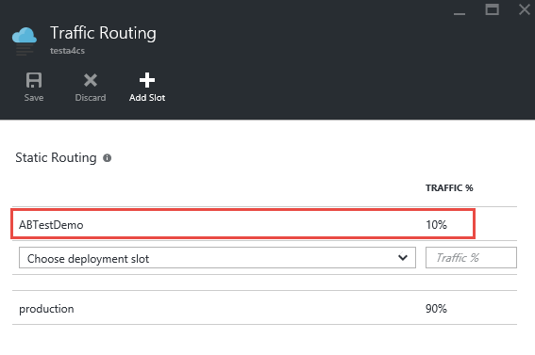
A/B Testing
Test changes by routing requests to different deployment slots
Use Traffic Routing to direct % of traffic to alternate slots
Notes:
A/B testing is useful for determining which of two landing pages, for example, is more effective in engaging customers. With Azure Web Apps, you can easily route traffic to different deployment slots by specifying percentage-based traffic allocations in the portal.

Slide 12






Continuous Integration
Web apps can be deployed manually via FTP or WebDeploy
Automate deployment using 3rd party source-control providers
Can also use a local Git repository from Azure Portal
Git
Visual Studio Team Services
CodePlex
GitHub
BitBucket
DropBox
Notes:
Continuous integration means deploying updates to your Web app as often as needed -- even several times a day. Azure supports many different deployment methods, including FTP, Git deployment (publishing from a local Git repository to Azure), and WebDeploy, which supports diff-deployment, database creation, and more. Visual Studio has integrated support for all three. Teams can also publish via third-party source-control providers such as Kudu (https://github.com/projectkudu/kudu/wiki/Deployment), which supports deployments from OneDrive and Dropbox, as well as repository-based deployments from GitHub, BitBucket, VSTS, and local Git repositories. For more information, see https://azure.microsoft.com/en-us/documentation/articles/web-sites-deploy/.

Slide 13


Continuous Integration + Deployment Slots
Production
5
Developer commits code
Automated process builds/compiles and deploys to staging slot
Automated and other tests validate content in staging slot
Staging content promoted to production
Users see updated site
1
4
2
3
Source Control
Staging
Test
Notes:
This process is a tried and tested one that is easily enacted using a combination of Azure features (e.g., deployment slots) and tooling support (e.g., Visual Studio).

Slide 14
App Service Plans
Billing and provisioning for App Service resources
 | Free | Shared | Basic | Standard | Premium
# of Apps | 10 | 100 | Unlimited | Unlimited | Unlimited
Shared Disk Space | 1 GB | 1 GB | 10 GB | 50 GB | 500 GB
Maximum Instances | 1 | 1 | 3 | 10 | 50
Autoscale | No | No | No | Yes | Yes
Staging Environments |  |  |  | 5 | 20
Custom Domains | No | Yes | Yes | Yes | Yes
SLA |  |  | 99.95%
Notes:
When you create an Azure Web App, you are asked to choose an App Service plan (or create a new one). These plans support 5 pricing tiers (Free, Shared, Basic, Standard, and Premium), with each tier offering a unique combination of capabilities and capacity. Apps in the same subscription and geographic location can share a plan. For more information, see https://azure.microsoft.com/en-us/documentation/articles/azure-web-sites-web-hosting-plans-in-depth-overview/.

